Slide 1
Spring RR Project
Sam Howley, 06/26/2024

Slide 2
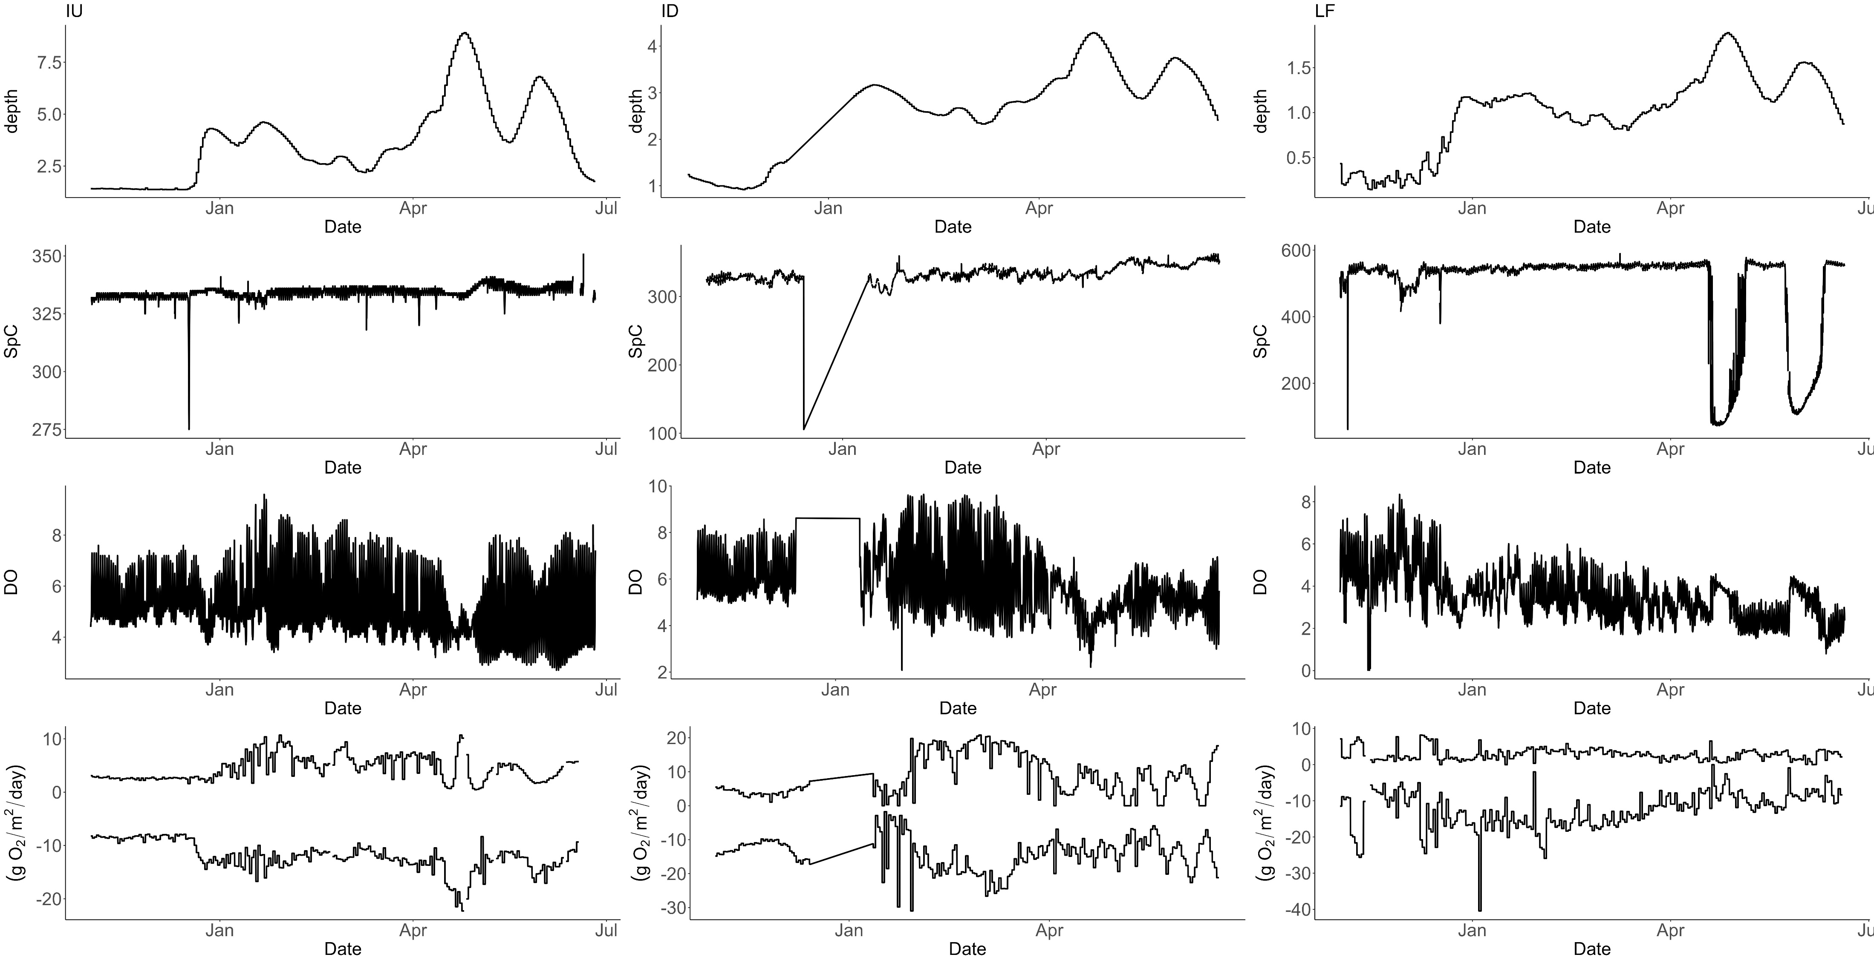
Brownout?
FR?

Slide 3
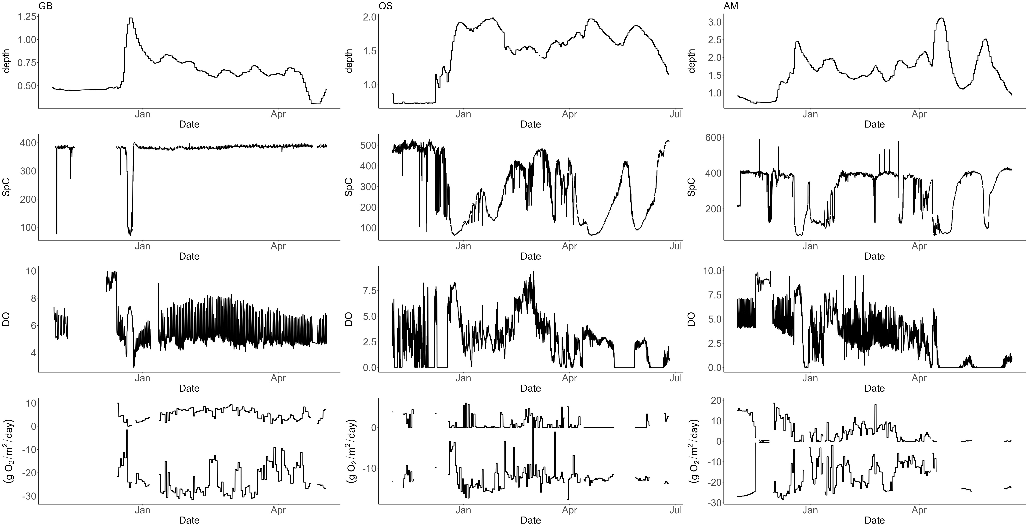
FR?
Brownout?
DO too low
DO too low
SM removes days ☹
SM removes days ☹

Slide 4
Site | Mean Stage (m) | Mean Reach (m) | Mean Discharge (m³ day⁻¹) | Study Period | h_{high} | h_{brown} | h_{reversal} | Total floods | Recorded floods
IU | 1.1 | 4950 | 303 | 07/20/2023- 06/20/2024 | 3 | 0 | 0 | 3 | 3
ID | 1.2 | 2900 | 668 | 07/20/2023- 06/20/2024 | 5 | 0 | 0 | 5 | 5
GB | 0.5 | 350 | 141 | 07/10/2022- 06/20/2024 | 3 | 1 | 2 | 5 | 4
LF | 0.5 | 320 | 58 | 07/12/2022- 02/20/2024 | 4 | 1 | 1 | 6 | 3
OS | 1.0 | 1350 | 165 | 07/20/2022-2/20/2024 | 4 | 4 | 1 | 9 | 8
AM | 1.4 | 1000 | 516 | 07/20/2023- 06/20/2024 | 6 | 5 | 2 | 13 | 13

Slide 5
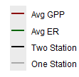
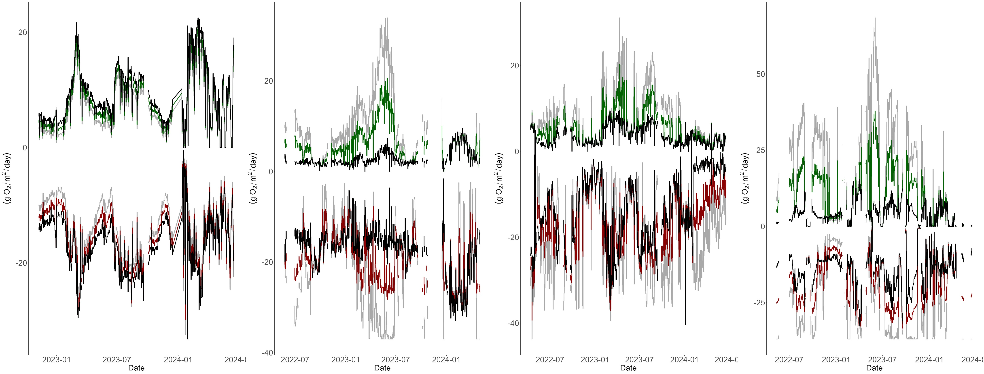
To “smooth” the transition between one and two station, I took the average between one and two results.
Low stage metabolism between 1 and 2 are similar. Larger differences during disturbances.

